Slide 1
Complexity Analysis
Unit 1
CPRG304 – Object-Oriented Programming III

Slide 2
Software Development
Problem
  Developing software to solve a problem
Algorithm
  Design a solution to the problem
Program
  Implementing the solution (the source code)
Process
  Run the program to check if it solved the problem

Slide 3
Algorithms
A step-by-step instructions to solve a problem or complete a task
  An algorithm must be designed to solve a stated problem
  The algorithm will be performed by some processor
    A machine or a human
    The algorithm must be expressed in a language or notation that the processor “understands”
    The algorithm must be expressed in steps that the processor is capable of performing
  The algorithm must eventually terminate, producing the required answer
  No algorithm is allowed to rely on qualities such as insight, creativity etc. that distinguish humans from machines!
Notes:
The problem must be solvable by an algorithm, there are many problems in Math and Computer Science are unsolvable by algorithms.

Slide 4
Algorithms in Practice
The same problem can frequently be solved with different algorithms
  Use the “best” algorithm!
  How would you compare the algorithms and rate them?
  What would determine that one is “better” than the other?
  What would your criteria be?
    Time?
    Memory usage?
    Human costs to develop?
    Human costs to maintain?
    Accuracy?

Slide 5
Complexity Analysis
The study of the performance (i.e. efficiency) of different algorithms
2 categories of algorithm efficiency:
  Time Complexity
    How long it takes to run the algorithm
    Measurement of processor time to perform all the steps in an algorithm
  Space Complexity
    How much space the algorithm needs for storing data
    Measurement of the amount of memory is used during the execution of the algorithm

Slide 6
Current State of Technology
We now have cheap and plentiful RAMs!
  Space complexity is not as crucial to determining the efficiency of an algorithm
    Still important depending the type of system you’re developing for or applications that require memory to be managed effectively
  We will focus on time complexity
Note: Time complexity and space complexity are highly correlated – it’s always a trade-off!
  Better time efficiency means using more space
  Better space efficiency means taking more time

Slide 7
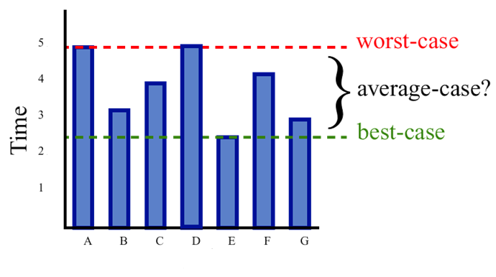
Time Complexity
How long it takes to run the algorithm
  The running time depends on the input data
  The algorithm may run faster on certain data sets than on others

Slide 8
Average Case vs. Worst Case
Finding the average-case can be difficult
  In certain application domains (e.g. air traffic control, authentication, surgery, IP lookup) knowing the worst-case time complexity is of critical importance
Algorithms are measured by the worst-case time complexity (upper-bound)
  It will take this maximum amount of time to run
    E.g. it will take at most 5 milliseconds to complete
  In some applications, it would be beneficial to provide the best-case (lower-bound) as well
    E.g. it will take between 2 to 5 milliseconds to complete
Notes:
instead of average-case: the algorithm will take on average 3.5 milliseconds, which really doesn’t mean much…

Slide 9
Measuring the Running Time
How should we measure the running time of the algorithm?
  Real time – ns? ms? sec?
Experimental analysis/benchmarking:
  Write a program to implement an experiment
  Run the program with data sets with varying size and composition
  Get a measure of actual running time (stop – start)
Example: Concat.java
Notes:
https://www.unlogged.io/post/java-and-the-string-odyssey-navigating-changes-from-jdk-1-to-jdk-21

Slide 10
Experimental Analysis
Benchmarking for running time
    long start = System.currentTimeMillis();
    // run algorithm
    long stop = System.currentTimeMillis();
    time = stop – start;
Every run will have different results
  Real-time measurements depends on the hardware, operating system, system configurations and other software currently running as well
  Any algorithm can run faster using a faster processor!

Slide 11
Limitations of Experimental Analysis
You need to implement the algorithm and run it in order to determine its running time
  Implementation may differ
In order to compare 2 algorithms, the identical computing environment must be used
  Exact hardware, software etc.
Experiments can only be done on a limited set of data inputs (e.g. TEST_SIZE)
  May not be indicative of the running time on other inputs not included in the experiment
Notes:
Try adding a few more 0’s to the TEST_SIZE…

Slide 12
Beyond Experimental Analysis
We will need to use a general methodology for analyzing algorithms:
  A high-level description of the algorithm is used instead of testing one of its implementations
  Can take into account all possible inputs
  Allows evaluation of efficiency of any algorithm that is independent from the software/hardware environment
Fun fact: The “father” of algorithm analysis is Donald Knuth
  If you find an error in any of his books, he sends you money

Slide 13
Algorithm Analysis
First we need a high-level description of the algorithm to analyze
  Recall: Algorithm = step-by-step procedure
How do we represent an algorithm?
  Flowcharts
  Pseudocode: a description of an algorithm in plain language that is more structured than the usual prose, but less formal than a programming language
    Intended to be read by humans
    Programming language independent, but we will use a Java-like style

Slide 14
Power Algorithms
Problem: to compute b^{n}, n>0, n∈I
  Solution A – Simple Algorithm:
      Set x to 1
      For ( int i=0; i<n; i++ )
        Set x = x * b
      Terminate with answer x
  Solution B – Smart Algorithm:
      Set x to 1, set y to b, and set z to n
      While z > 0:
        If z is odd then set x = x * y
        Divide z by 2 (discard remainder), set y = y * y
      Terminate with answer x
Notes:
If you prefer to read real Java code, check out the powerAlgorithms package!
Note: For loops are usually written in pseudocode as “For i = 1 to n” but I thought the actual code will make it easier for you to remember exactly which operations are involved! :D

Slide 15
Algorithm Analysis
With our pseudocode, now we need to analyze the running time
  Go through the algorithm line-by-line and calculate the worst-case
This is done by counting the total number of operations
  Arithmetic operations: +, -, *, / etc.
  Comparison operations: <, >, etc.
  Assignment operations: x = y
    Note: increment (++) and decrement (--) are really 2 operations – 1 arithmetic (+/-) and 1 assignment (=)

Slide 16
Counting – Simple Power Algorithm
n is the power value of b^{n}
Set x to 1
    1 assignment
For ( int i = 0; i < n; i++ )
      Start: 1 assignment, 1 comparison
      Each iteration: 1 increment (arithmetic + assignment), 1 comparison
        There are n iterations
    Total: n+1 assignment, n+1 comparison, n arithmetic
  Multiply x by b
    n arithmetic, n assignment
Terminate with answer x
Total = 2n+2 assignment, n+1 comparison, 2n arithmetic
f(n) = 5n + 3
Notes:
Running time changes as the input size n changes, so it’s expressed as a function of n.

Slide 17
Divide and Conquer Algorithms
Break the problem into smaller subproblems (e.g. into 2 = half) and solve them individually
  Usually involves breaking down each subproblem repeatedly until it is simple enough to be solved directly
    Can be implemented with loops or recursion
Basis for most efficient algorithms
Great for running on multiprocessors with caches
  Each subproblem can run independently on a processor
  Subproblem is small enough to fit in cache
Notes:
No need to access main memory.

Slide 18
Divide and Conquer Analysis
Using integer division (discard remainders)
Start with n, divide it by 2 (n/2) until answer is 1
  Count how many times we need to perform the division
    5/2 = 2/2 = 1 (divide 2 times)
    10/2 = 5/2 = 2/2 = 1 (divide 3 times)
    100/2 = 50/2 = 25/2 = 12/2 = 6/2 = 3/2 = 1 (divide 6 times)
    1000/2 = 500/2 = 250/2 = 125/2 = 62/2 = 31/2 = 15/2 = 7/2 = 3/2 = 1 (divide 9 times)
    1,000,000/2 = 500,000/2 = 250,000/2 = 125,000/2 etc. (divide 19 times)
    1,000,000,000/2 (divide 29 times)
    1,000,000,000,000/2 (39 times)
    1,000,000,000,000,000,000,000,000,000,000/2 (divide 79 times)

Slide 19
Divide and Conquer Performance
The number of divisions can also be calculated using logarithms:
  Log₂ 5 = 2.322 → floor = 2
  Log₂ 10 = 3.322 → floor = 3
  Log₂ 100 = 6.644 → floor = 6
  Etc.
  Thus: floor(log₂ n)
    But this is for when we get to answer of 1
    We need to account for this last value!
The exact formula: floor(log₂ n) + 1
Floor is rounding down to the nearest whole number! We do this because we’re working with data in SD, and we can’t have a fraction of a single piece of data! (e.g. an array of size 2.322)

Slide 20
Counting – Smart Power Algorithm
*note: z is divided by 2 at every iteration, recall n = 0 after doing n/2 floor(log₂ n) + 1 times? That means this loop will execute floor(log₂ n) + 1 times! (Note: the +1 here is the last iteration where the condition is false and the while loop terminates)
Set x to 1 – 1 assignment
Set y to b – 1 assignment
Set z to n – 1 assignment
While z > 0: – 1 comparison + *note
  If z is odd then – modulus + comparison
  Set x = x * y – arithmetic + assignment
  Divide z by 2 (discard remainder) – arithmetic + assignment
  Set y = y * y – arithmetic + assignment
Terminate with answer x
f(n) = 9(floor(log₂ n) + 1) + 3

Slide 21
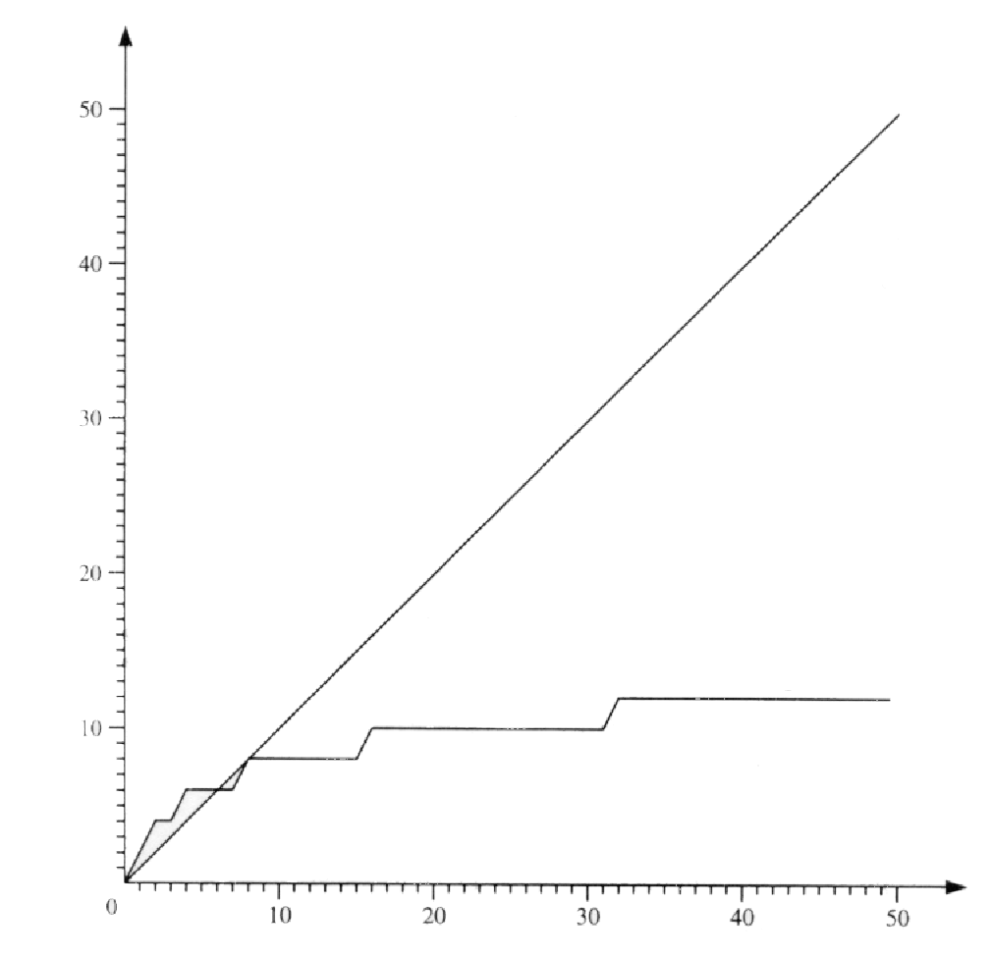
Comparing the Power Algorithms
f(n)
simple power
algorithm
smart power
algorithm
n

Slide 22
Growth Rates
Actual times taken by algorithms is great, but we are more interested in the growth rate for each algorithm
  Specifically – as we increase the input size n, the running time will also increase
  How much increase (the change in running time) is the most important part of algorithm analysis!
    E.g. Simple vs. Smart
As the value of n increases, the constants is unaffected
  E.g. 5n + 3: the 5 and 3 will become negligible
  So we can ignore them!

Slide 23
The Big O Notation
The standard way to represent upper-bound (worst-case) of growth rates for both time and space complexity
  Discard any constant factor in the fastest growing term
  E.g. 5n + 3: discard the 3 and 5 → n = O(n)
    Pronounced “Big O of n” or “order of n”
  E.g. 9(floor(log₂ n) + 1) + 3 → O(log n)
    Pronounced “Big O of log n” or “order of log n”
    Convention: O(log n) instead of O(log₂ n) since the base of the logarithm does not matter (just another constant)
  If more than one term: Keep the fastest-growing term in the formula, discard all slower-growing terms!

Slide 24
Common Big O:
Growth Rate vs Performance
O(1) constant grows slowest runs fastest
O(log n) logarithmic
O(n) linear
O(n log n) linearithmic
O(n²) quadratic
O(n³) cubic
O(n^{k}), k>1 polynomial
O(2^{n}), n>1 exponential
O(n!), n>1 factorial grows fastest run slowest
Notes:
Have you ever heard people talk about things growing exponentially? Now you know what that really means!

Slide 25
Practice
Identify the growth rates in the following functions:
f(n) =
  2¹⁰⁰⁰
  5n + 7 log₂n
  10n⁴ + 10n log₂n + 5
  3 log₂n + 42
Notes:
Answers:
O(1)
O(n)
O(n⁴)
O(log n)

Slide 26
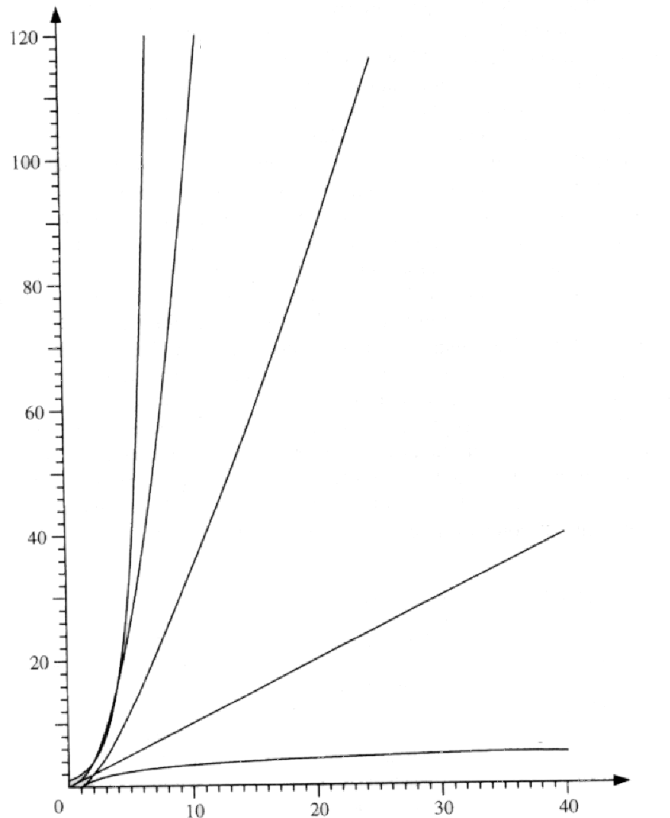
Comparing the Growth Rates
2^{n}
n²
n log n
Ultimately we want to know which algorithm is “better”?
Faster growth rate = takes longer time or uses more memory as n increases = bad!
Slower growth rate = better performance!
n
log n
n
Notes:
Golden Rule: O(1) < O(log n) < O(n) < O(n log n) < O(n²) < O(n³) < O(n^{k}) < O(2^{n}) < O(n!)

Slide 27
Practice
Given the following 2 algorithms, which one is better?
  1. for each n {
  // some code
  }
  2. for each n {
  for each n {
  // some code
  }
  }
Notes:
Answer:
O(n)
O(n²)
1 is better.

Slide 28
Beware of Large Constants!
For each n {
  // 5,000,000,000 operations
  }
  5,000,000,000n = O(n)
For each n {
  For each n {
  // 5 operations
  }
  }
  5n² = O(n²)

